Slide 1
HATE SPEECH DETECTION

Slide 2
Introduction
Nowadays hate speech, through various medium is very common to see and read about it.
It has become one of the biggest problems seen by the society and Identifying hate speech on social media is a crucial first step toward addressing this problem head-on and preventing it from spreading even further.
Due to some of these event takes happens in the day-to-day life there is serious need to counter this problem to protect the society from hate.
In today's world even young people are also on social media and many other media sites through which they consume content. So, it’s very for them hear and see hate speech and exchange inappropriate words.

Slide 3
Identification of need/problem
The identification of the need or problem of hate speech detection and masking is grounded in the increasing prevalence of hate speech on digital platforms and the potential harm it causes to individuals and society.
Positive features of identifying hate speech using AI are that with the help of it, people can identify the hateful content on a large scale at the same time it helps in identifying victims of the hatred
It will help to suppress Cyberbullying and to reduce hateful propaganda.

Slide 4
LITERATURE SURVEY
Hate speech has been an ongoing problem on the Internet for many years. Besides, social media, especially Facebook, and Twitter have given it a global stage where those hate speeches can spread far more rapidly.
Every social media platform needs to implement an effective hate speech detection system to remove offensive content in real-time.
There are various approaches to identify hate speech, such as Rule-Based, Machine Learning based, deep learning based and Hybrid approach.

Slide 5
PROPOSED SYSTEM
Our project aims to identify hate speech over the internet and censor it.
In our project, we are going to develop a chrome extension to identify certain keywords and sentences which are inappropriate and abusive and falls under the hateful speech category.
To address this problem, this project proposes a solution of using a machine learning algorithm integrated into a Chrome extension for real-time hate speech detection. The proposed solution aims to provide users with a safer and more inclusive online environment by detecting and flagging hate speech in real-time, while also increasing awareness about the prevalence and impact of hate speech online.

Slide 6
Advantages
Increased awareness: By detecting hate speech in real-time, users of the extension will be more aware of the prevalence of hate speech online and can take steps to avoid it.
Empowerment: The extension empowers users to take control of their online experience by giving them the ability to detect and block hate speech.
Positive features of identifying hate speech using AI are that with the help of it, people can identify the hateful content on a large scale at the same time it helps in identifying victims of the hatred.
It will help to suppress Cyberbullying and to reduce hateful propaganda.
A Chrome extension is easily accessible to anyone who uses the Chrome browser, making it a convenient way to detect hate speech online.

Slide 7
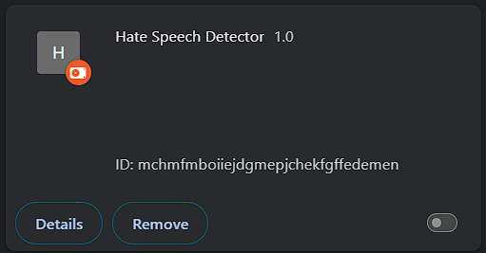
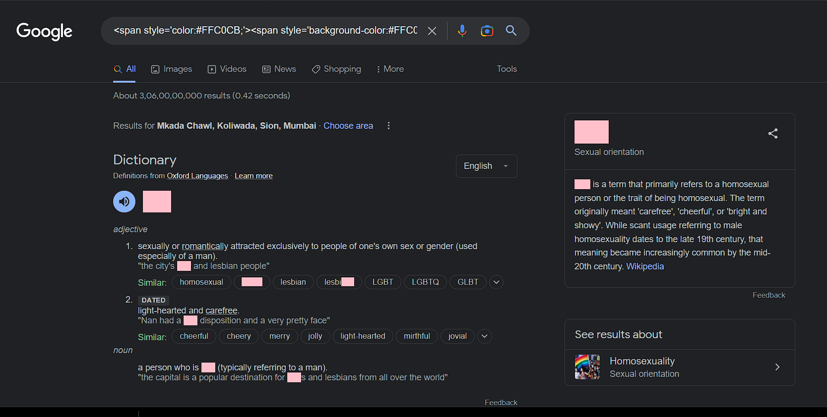

Slide 8
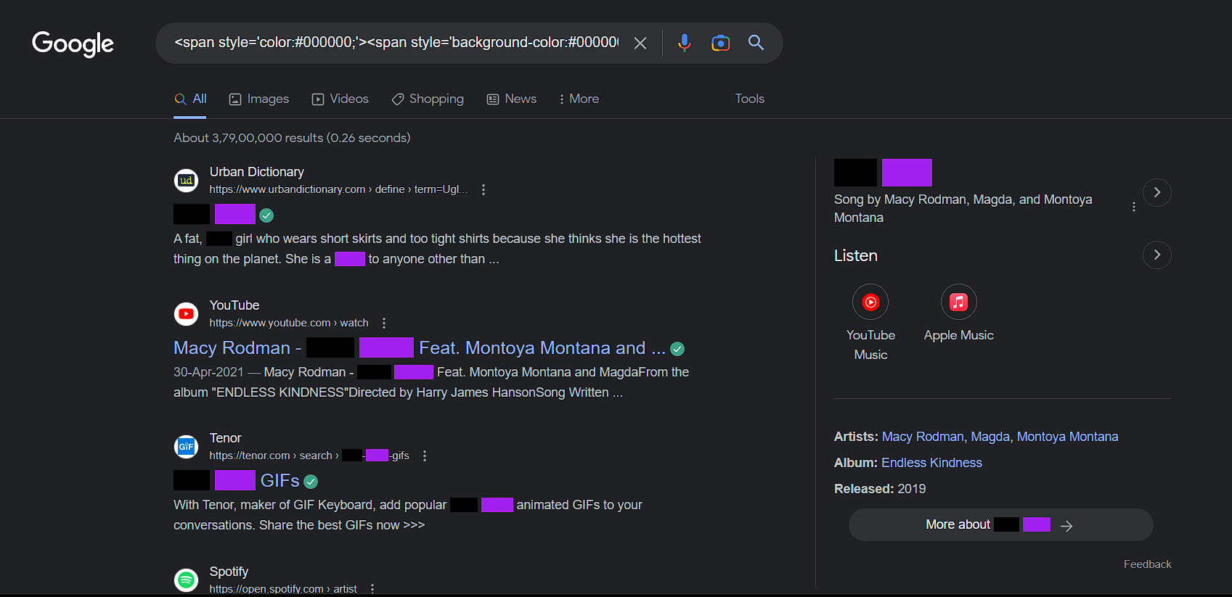
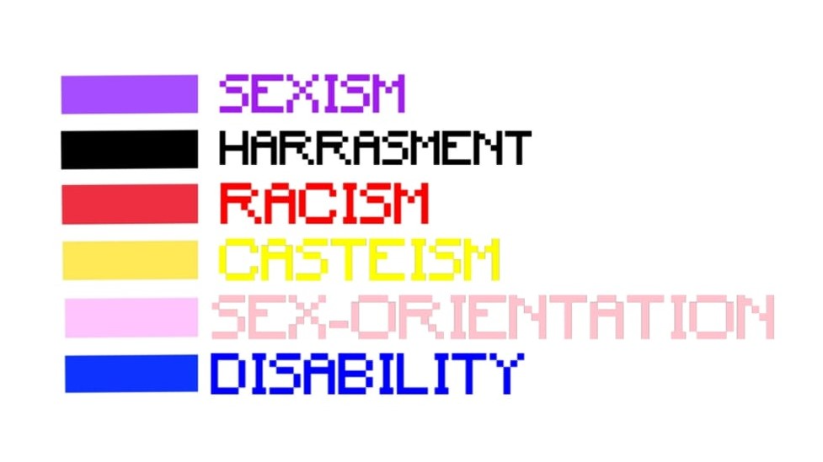

Slide 9
This aims to classify textual content into non-hate or hate speech, in which case the method may also identify the targeting characteristics (i.e., types of hate, such as race, and religion) in the hate speech.
This project is expected to contribute to the development of unbiased, factbased conversations on the internet. Overall, hate speech detection using a Chrome extension has the potential to make a positive impact on the online community by promoting respect, inclusivity, and safety for all users.

